Slide 1
Boundary Handling

Slide 2
Boundary handling is done with respect to tiles.
Tile is the basic parallelization unit in Hadoop GIS.
Boundary Object : Objects which lie on tile boundaries.
The fraction of boundary objects is inversely proportional to tile size.

Slide 3
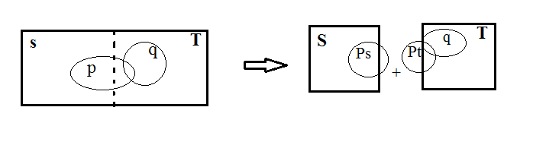
Boundary object illustration

Slide 4
Approaches to Handle
There are two basic approaches to handle boundary objects.
They have to be Specially processed to guarantee query semantics and correctness.
They can be Simply discarded.
Which is suitable?

Slide 5
Remedies
Pre-processing task : Boundary objects are duplicated and assigned to multiple intersecting tiles.
Post-processing task : Objects are filtered where duplicate records are eliminated.

Slide 6
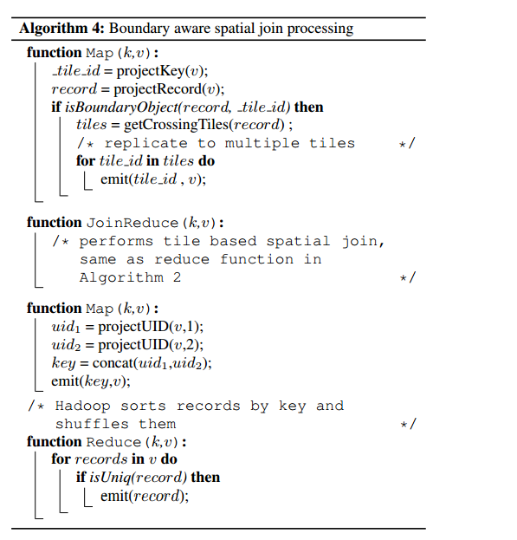
Boundary aware spatial join processing algorithm

